Slide 1
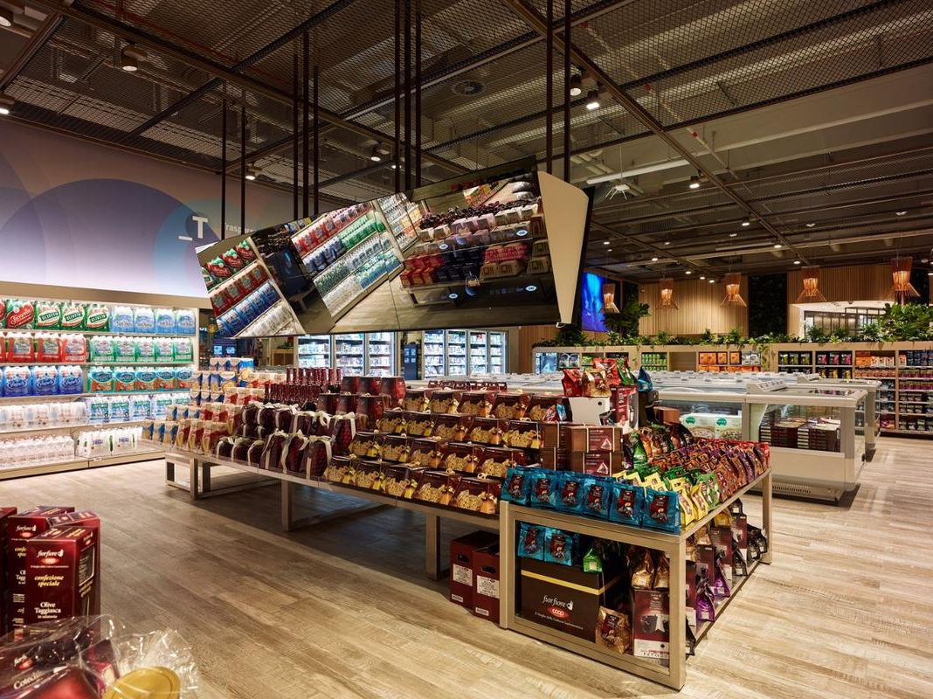
Project: Super Shop
Name:Tanzilur Rahman
Student ID:200595789
Instructor: Syem Ishaque

Slide 2
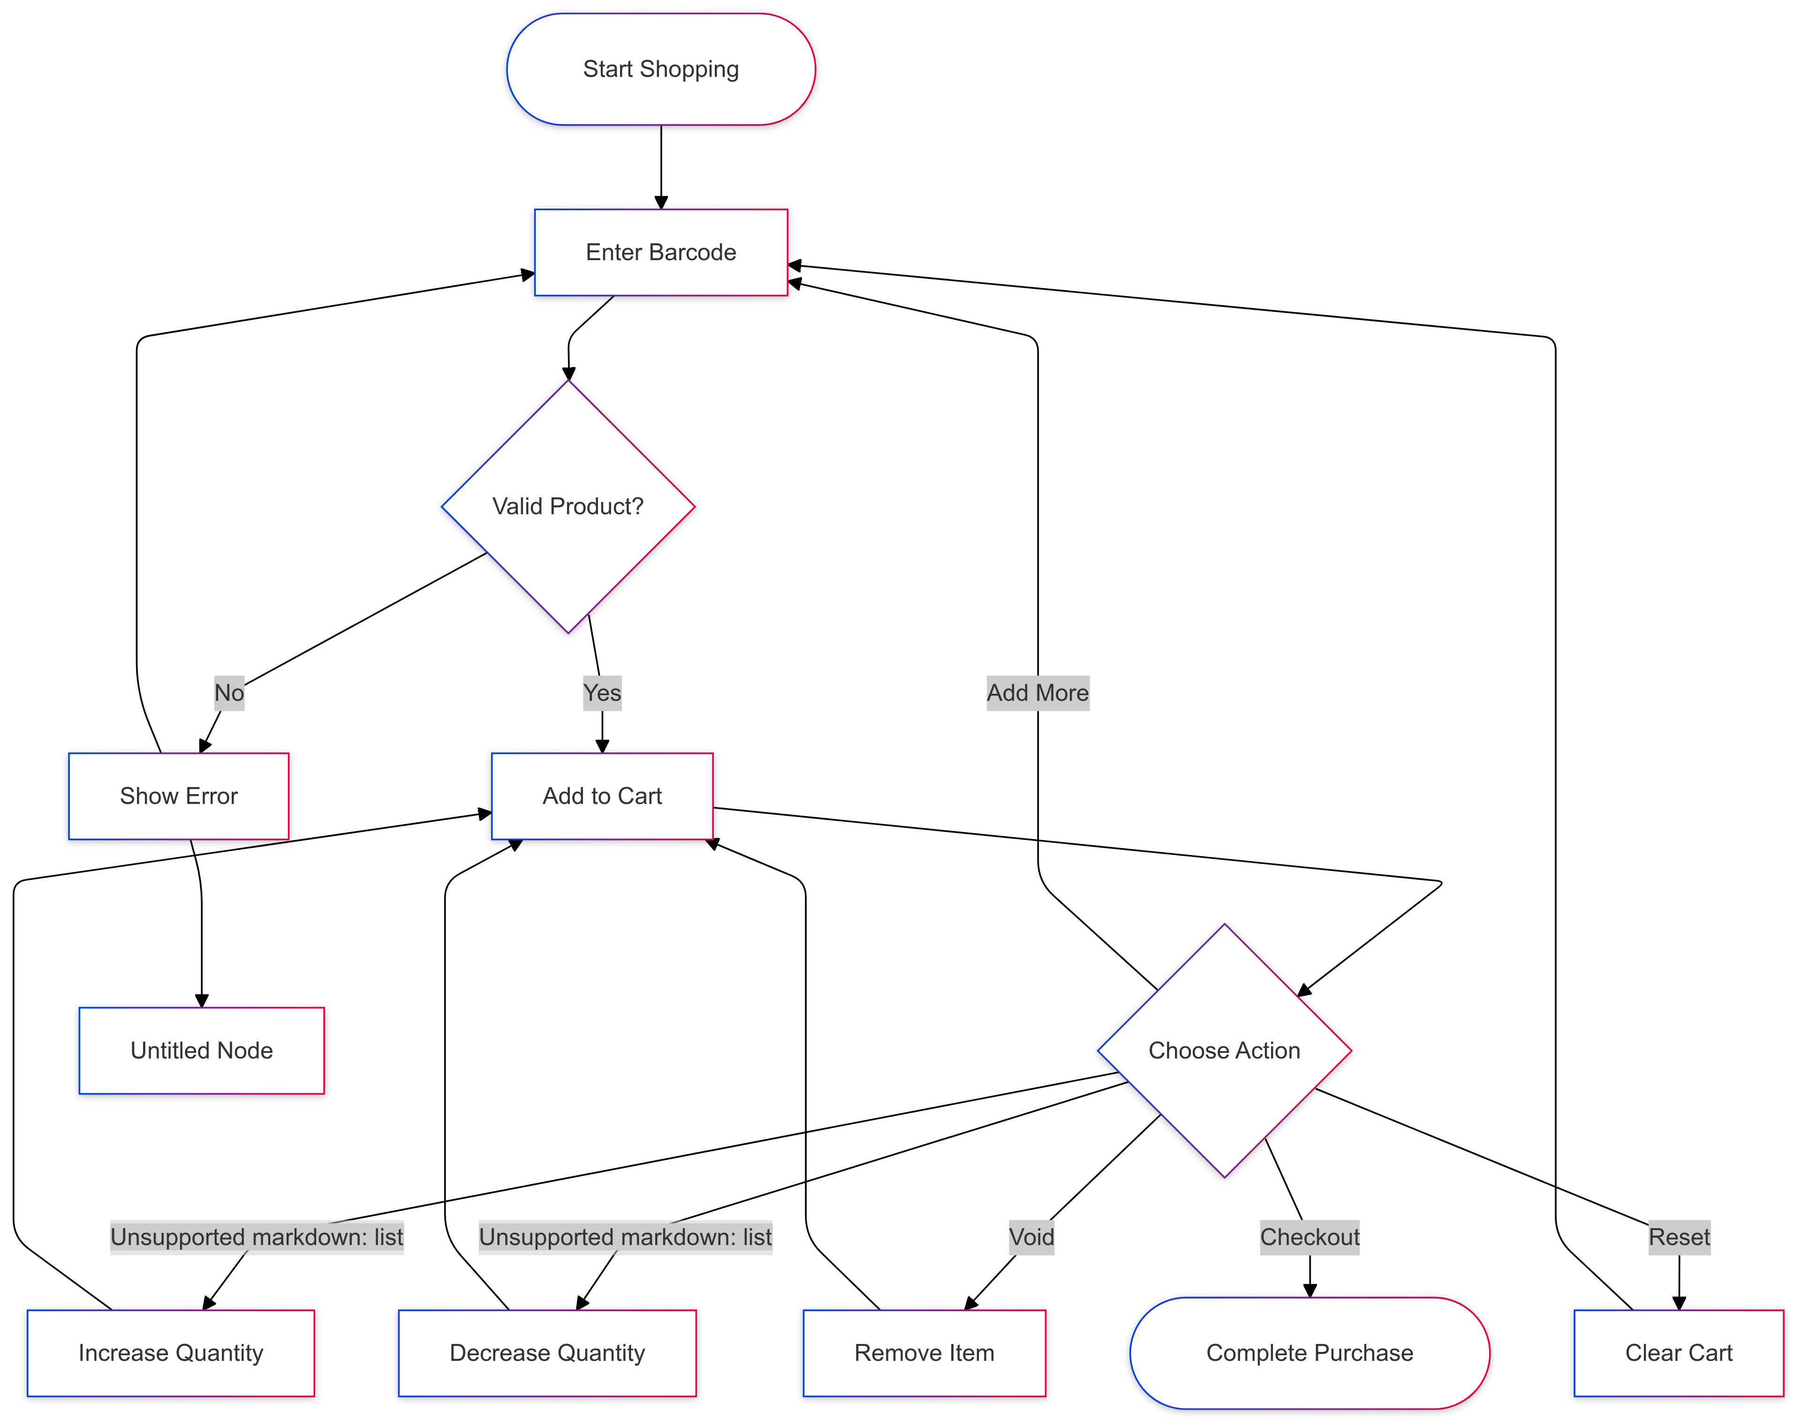
FLOW CHART

Slide 3

Introduction This project implements a PHP-based system to manage products and transactions.
Key Features:
Loading product data from a CSV file.
Dynamic display of items in a table.
Calculation of total prices for scanned items.
Significance:
Enhances inventory and point-of-sale management using efficient backend logic.

Slide 4

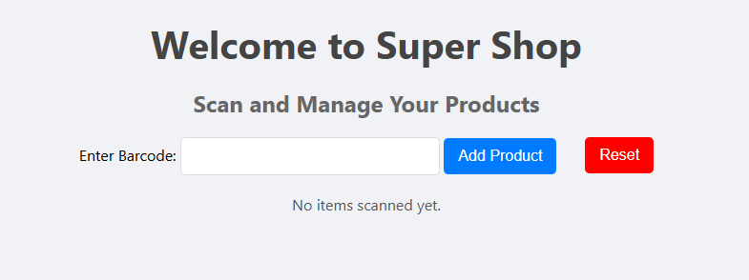
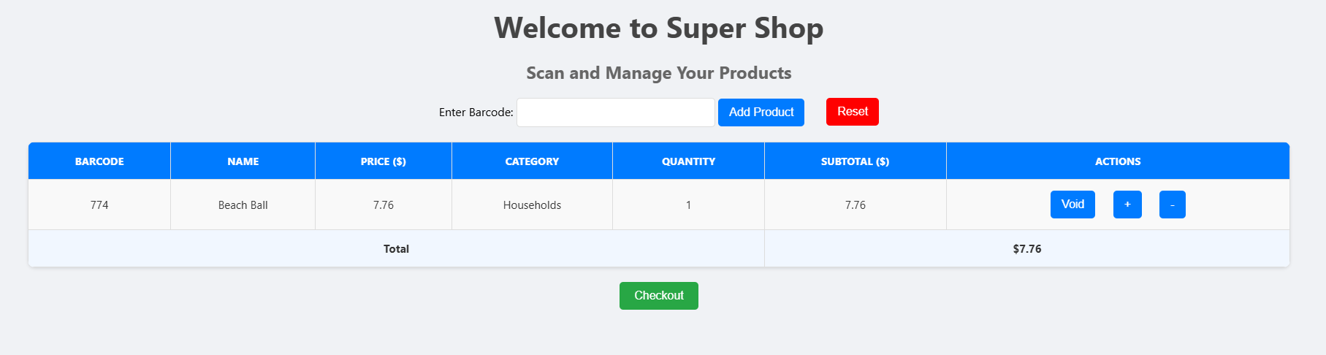
After adding an item into the cart
Initial view
Add To cart Button
Reset Button
Buttons for item actions

Slide 5
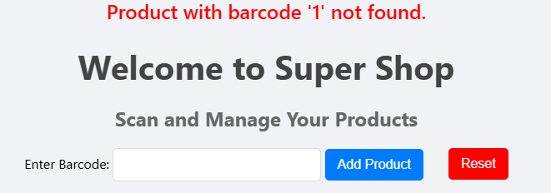
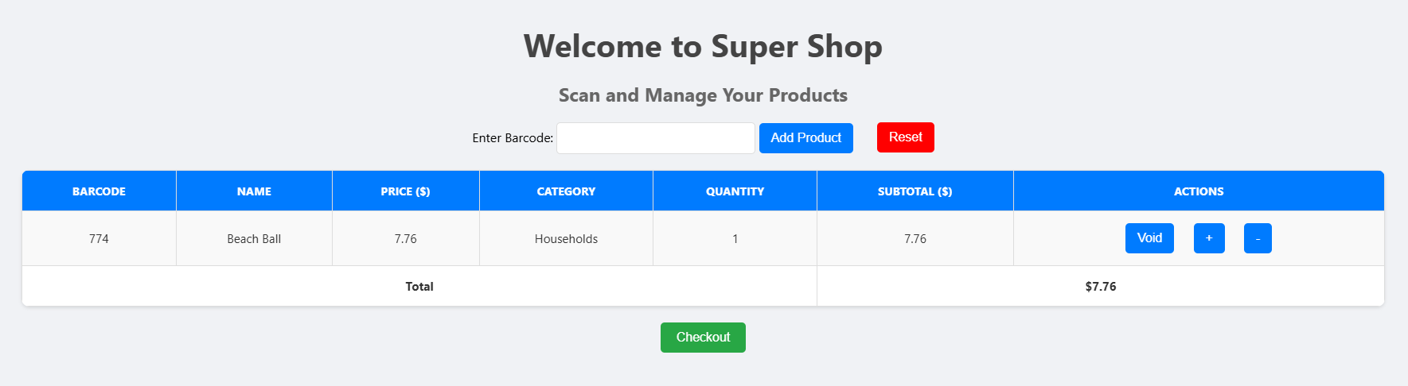
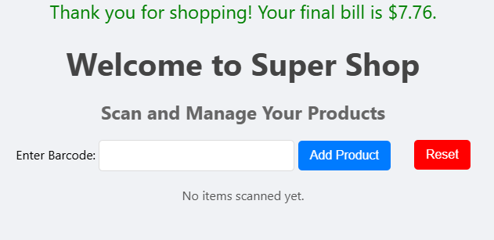
INVALID Barcode
Checkout button & Implication
checkout Button

Slide 6
Method
1. Loading Product Data:
- Function: `loadProductsFromCSV`
- Reads a CSV file and organizes data into an associative array.
2. Displaying Items:
- Function: `displayTable`
- Dynamically generates an HTML table to display product details.
3. Session Management:
- Tracks user session to persist scanned items.
Visual Representation:
- CSV Data → Backend Processing → Frontend Table Display

Slide 7

Results
Test Case:
- Input CSV: Products with fields (Barcode, Name, Price, Category).
- Output: A dynamic table displaying the scanned items with calculated totals.
Example:
1. Scanned items are shown in a well-structured table.
2. Total price is calculated and displayed in real-time.

Slide 8
Discussion
What Worked:
- Dynamic loading and display of data.
- Accurate calculation of totals.
What Needs Improvement:
- User interface could be more interactive.
- Add data validation for robustness.
- Consider integrating a database for scalability.

Slide 9
Conclusion
This project demonstrates a basic inventory and transaction management system.
Implemented Features:
- CSV-based product loading.
- Dynamic table generation for scanned items.
- Session tracking for user persistence.
Future Work:
- Transition to a database-driven backend.
- Enhance user experience with better UI and validations.

